Slide 1
Big Data Platforms
Israeli Police Data Analysis
Group members: Baruch Hanya, Yaniv Tordjman, Adar Assif

Slide 2
General Background
Crime trends in Israel
Usually unknown, mostly until few years ago
Media report / general feeling VS. Actual reality
Hard to decide on enforcement strategies
2019 – The Movement for Free Information applied to the Ministry of Homeland Security
The Israeli Police released the information to the general public

Slide 3
Our goal
Improve the law enforcement mechanisms
Recommend efficient courses of actions
Eventually – better homeland security at specific state
In our case – Israel…

Slide 4
The Solution
Analyzing given data to define trends
Giving practical solutions regarding our results:
Concentrate the efforts of the various enforcement agencies
Prevention improvements - resources
Hopefully will create more efficient work
For further work - finding social-economics trends

Slide 5
Difference
Our work will relay on trends and not just basic data analyze
Applying methods that we learned in works from all around the world, on the crime data in Israel
We will also try to discover different trends here in Israel that were not studied yet

Slide 6
The method
Database modification
Initial analysis
Establishing crime rate score
Translating Hebrew → English
Fixing damaged data
Merging other parameters and features
Basic segmentation of crime
Geographic area
Time period
Crime types
Deep analysis and prediction
Based on the analyzed features
Using basic ML techniques

Slide 7
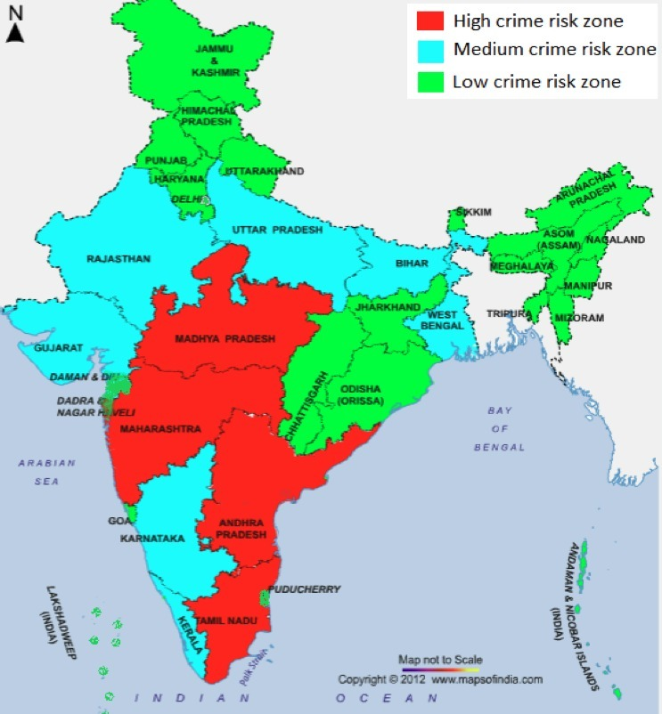
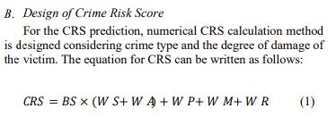
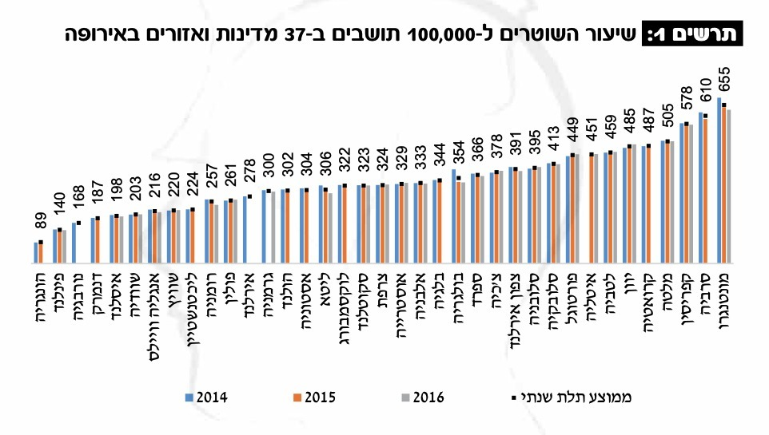
Literature review
Cluster based zoning of India
“Crime risk score” estimation
Statistical analysis the Israeli Police

Slide 8

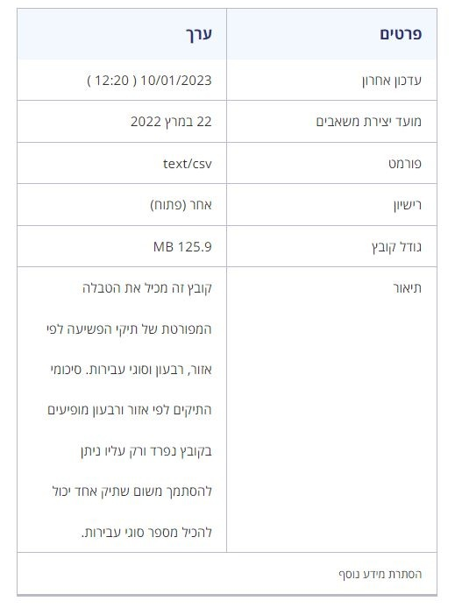
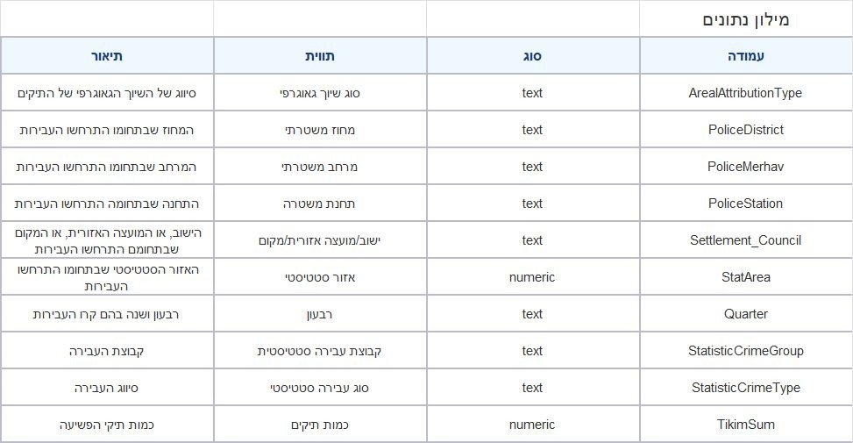
Databases overview

Slide 9
Desired results
Prediction of the crime trend by type of crime in a geographic area given parameters for that area
Find out how socio-economic status affects crime rate
Crime rates in COVID-19 comparing to same time in a normal year

Slide 10
Bibliography
Hsiu-chin Chen, Wingyan Chung, Yi Qin, Michael Chau, Jennifer Xu, G.Wang, Rong Zheng, and Homa Atabakhsh. Crime data mining: An overview and case studies. 12 2003.
Israeli Police. Crime records data.
The Movement for Free of Information. Letter to the ministry of homeland security.
Matthew Friedman James Cullen and Ames C. Grawert. Crime trends: 1990 - 2016. Brennan Center for Justice, 04 2017.
Dr Yakterina Yazamski. Multi-year decrease in property crimes in the last decade - analysis of statistical trends. Haykar Bamechkar 2017, page 61, 2017.
Myung-Sun Baek, Yong Tae Lee, Kwangho Jang, Heejo Lee, and Wonjoo Park. Design and performance evaluation of crime type and crime risk score estimation technique for fast and efficient response of severe crimes. In 2020 International Conference on Information and Communication Technology Convergence (ICTC), pages 1826–1828, 2020.
Lalitha Saroja Thota, Mohrah Alalyan, AL-Otaibi Awatif Khalid, Fabiha Fathima, Suresh Babu Changalasetty, and Mohammad Shiblee. Cluster based zoning of crime info. In 2017 2nd International Conference on Anti-Cyber Crimes (ICACC), pages 87–92, 2017.
Israeli Police. 2021 statistical review.
Ben Stickle and Marcus Felson. Crime rates in a pandemic: the largest crimino-
logical experiment in history. In American Journal of Criminal Justice, volume 45, pages 525–536, 2020.

Slide 11
Questions?

